Slide 1



PLANT

Slide 2

SasK Agriculture | Agriculture basics | Farming in 2018 | Canada and the World
$100 | $100 | $100 | $100
$200 | $200 | $200 | $200
$300 | $300 | $300 | $300
$400 | $400 | $400 | $400

Slide 3
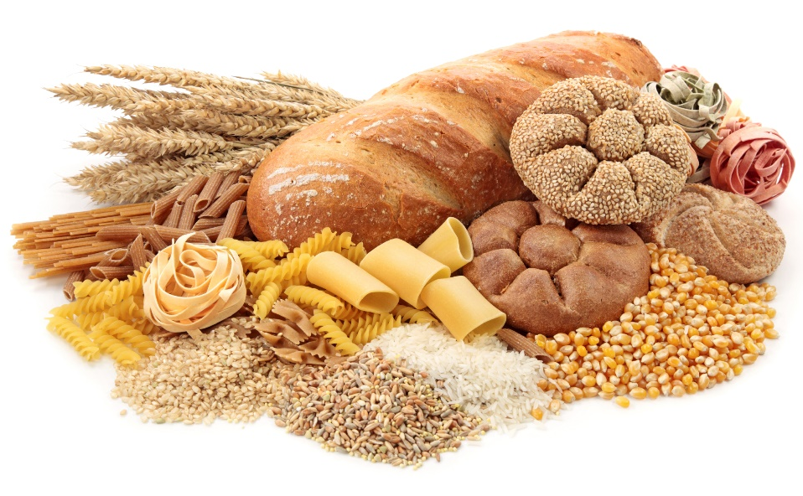
Why is Saskatchewan known as Canada’s Breadbasket?

Slide 4
Saskatchewan is the main producer of wheat in Canada and one of the largest in the world. Saskatchewan also has some of the richest agricultural soil in the world.
Click arrow to return to game board!

Slide 5
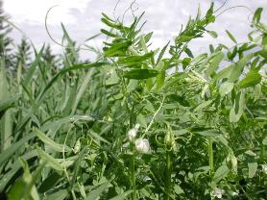
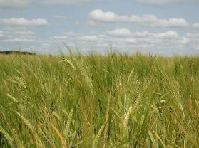
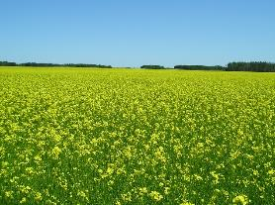
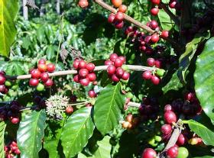
Which of the following is NOT grown in Saskatchewan?

Slide 6


Which of the following is NOT grown in Saskatchewan?
Lentils
Barley
Click arrow to return to game board!
Mustard
Coffee Beans

Slide 7
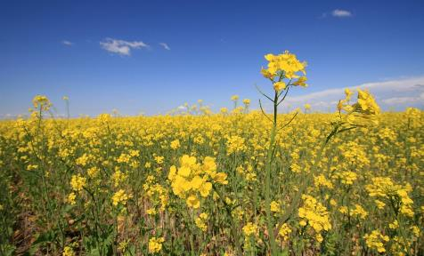
Canola was invented by scientists in Saskatchewan and Manitoba. What does the name Canola mean?

Slide 8
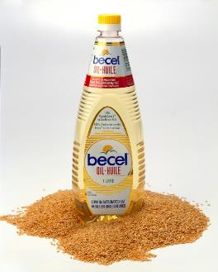
“Canadian Oil Low Acid”
Canola oil is a heart-healthy oil, bred to be low in erucic acid. It also has the lowest saturated fat content of any culinary oil.
Click arrow to return to game board!

Slide 9
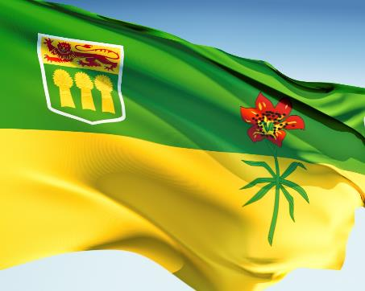
What are Saskatchewan’s provincial animal, fruit and mineral?

Slide 10
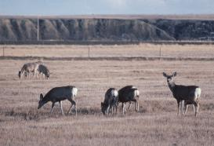
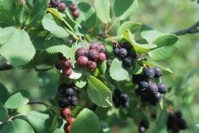
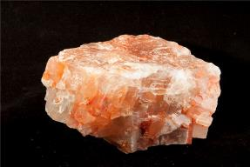
White-tailed deer, Saskatoon berries and potash!
Click arrow to return to game board!

Slide 11
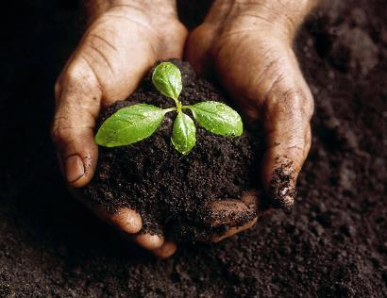
What 5 ingredients
are needed to make
a healthy soil??

Slide 12
Minerals
Water
Organic matter
Air
Living organisms
Click arrow to return to game board!

Slide 13
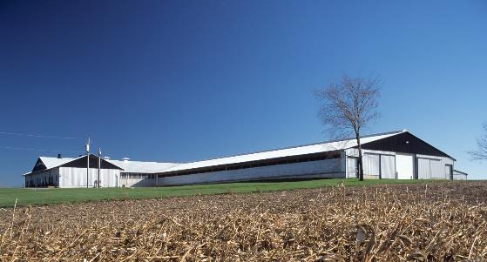
Why are animals like pigs and chickens usually kept inside barns?

Slide 14
Barns help to protect livestock from extreme weather, diseases and predators like wolves and coyotes.
Barns also allow farmers to make sure animals are healthy and that they receive enough food and water.
Click arrow to return to game board!

Slide 15
Fossil fuels, such as coal, oil, and natural gas, are used to manufacture products and heat our homes. Where do Fossil fuels come from?

Slide 16
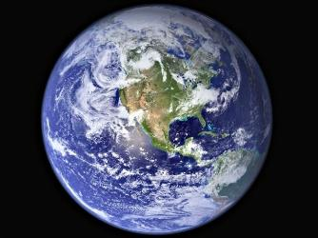
Fossil fuels were formed from the decomposition of ancient plants and animals over millions of years. They are found buried within the Earth!
Click arrow to return to game board!
Notes:
Coal is formed from the remains of ancient ferns, plants and trees. Due to pressure and heat, these plants hardened
Oil is formed from very small organisms, such as zooplankton and algae. High pressure caused the organic matter (organisms) to decompose into oil which is used for a variety of tasks.
Natural Gas undergoes the same process as oil; however, the process is longer and subject to higher amounts of heat and pressure, causing further decomposition.

Slide 17
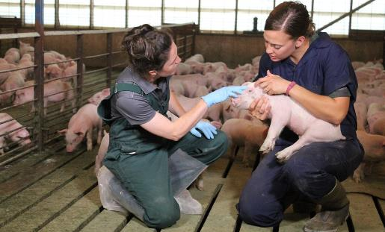
What is biosecurity and why is it important?

Slide 18
Biosecurity describes steps taken to keep animals healthy by preventing the spread of disease.
Some biosecurity practices include wearing special clothing when entering a barn and limiting visitors.
Click arrow to return to game board!

Slide 19
Why do farmers practice
crop rotation?

Slide 20
Planting different crops on a piece of land from year to year helps prevent the build up of diseases, pests and insects.
Different crops also need different nutrients, so rotating crops helps keep the soil healthy.
Click arrow to return to game board!

Slide 21
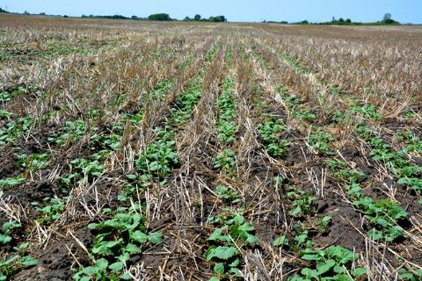
What is Conservation Tillage?

Slide 22
Conservation tillage means that crops are grown with little or no cultivation of the soil.
Plant materials from the previous year are left in the ground to provide organic matter and prevent erosion.
Click arrow to return to game board!

Slide 23
What is Precision
Farming?

Slide 24
Precision farming uses technology to analyze fields for soil fertility, moisture levels and crop production.
Farmers can target areas where specific amounts of water, nutrients or pesticides are needed, rather than use the same amount across the whole field.
Click arrow to return to game board!

Slide 25
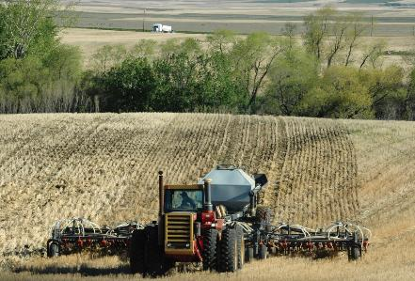
Agriculture is a major part of Canada’s economy. How many Canadians have jobs in Agriculture?

Slide 26
Approximately 1 in 8 Canadians works in Agriculture
(that’s about 4.6 Million people)
Click arrow to return to game board!

Slide 27
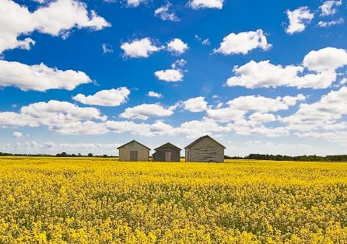
How much of Canada’s land is used for farming?
50%
7%
25%
80%

Slide 28
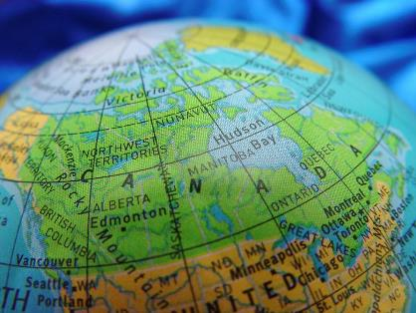
Despite it’s large size, only about 7% of Canada’s land is used for Agriculture
Click arrow to return to game board!

Slide 29
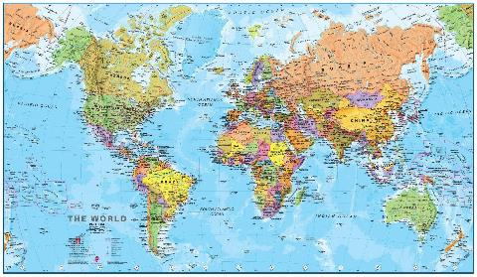
Canada is the leading exporter of pulses, like lentils and peas. What country is our top pulse trading partner?

Slide 30
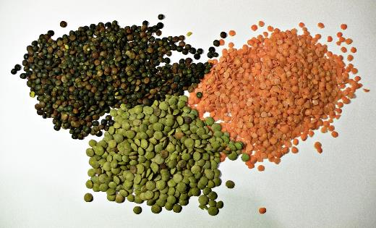
India!
Click arrow to return to game board!

Slide 31
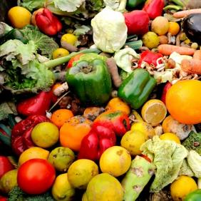
About 1/3 of the food produced for humans is lost or wasted . How is food wasted in Canada?

Slide 32
Buying more than you need
Not using leftovers
Large portions at home or in restaurants
Throwing out food that is past the best before date but still safe to eat
Click arrow to return to game board!

Slide 33
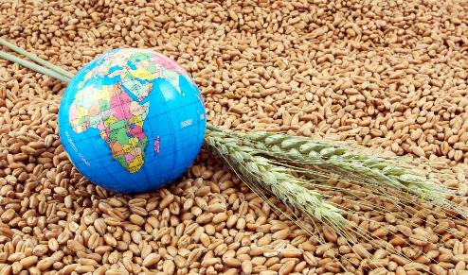
What are Canada’s top agricultural exports?

Slide 34
Wheat
Canola
Soybeans
Cattle
Can you think of some foods that Canada imports?
Click arrow to return to game board!

Slide 35
Thank You for playing Plant Jeopardy!

