Slide 1
PLANT

Slide 2
What am I? | the environment | animal/plant connections | What is my use?
$100 | $100 | $100 | $100
$200 | $200 | $200 | $200
$300 | $300 | $300 | $300
$400 | $400 | $400 | $400

Slide 3
I have many eyes.
I grow under the ground and you can eat me many different ways.
What vegetable am I?

Slide 4
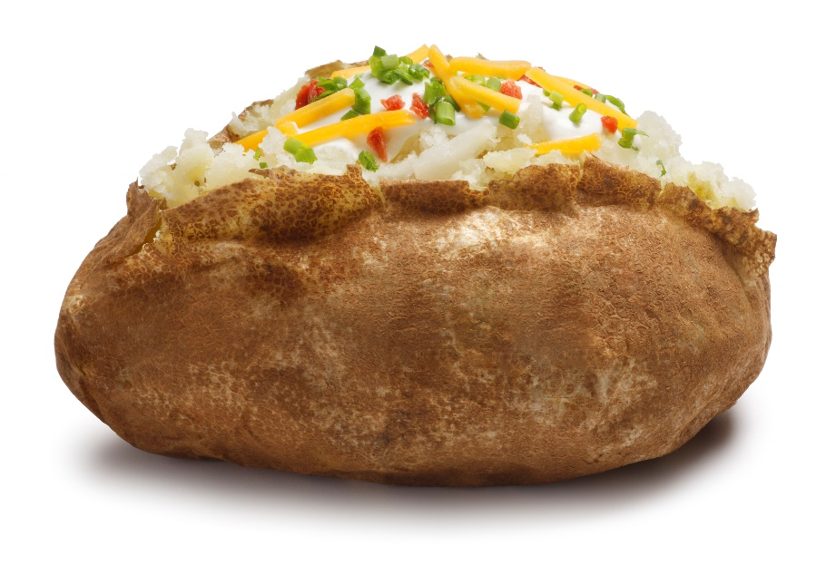
Potato!
Click arrow to return to game board!

Slide 5
I am green on the outside and red in the middle.
I have a round shape with black seeds inside.
What fruit am I?

Slide 6
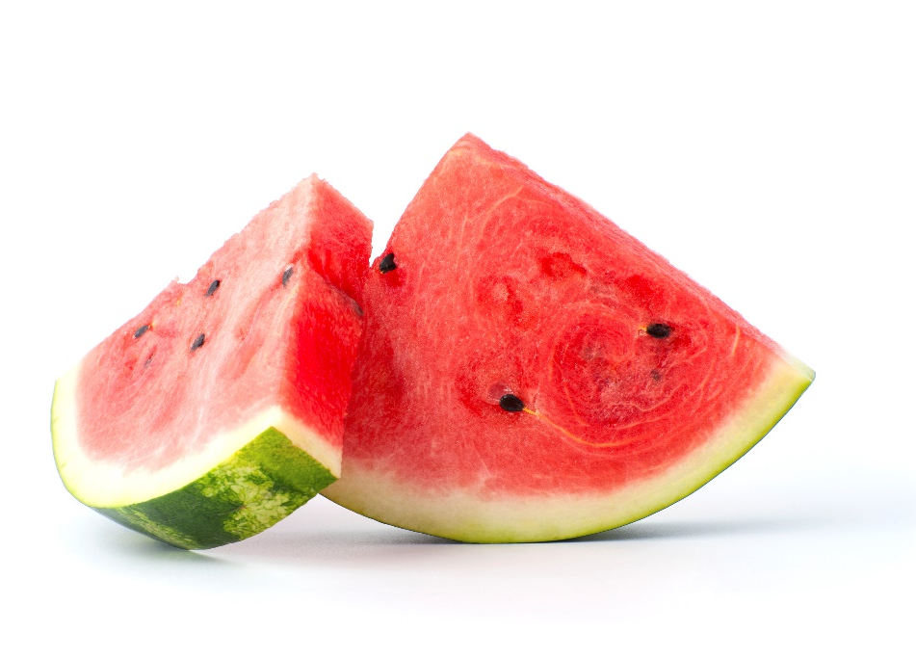
Watermelon!
Click arrow to return to game board!

Slide 7
I am golden yellow.
I usually have very big ears.
I am used to make tortillas.
What kind of vegetable
am I?

Slide 8
Corn!
Click arrow to return to game board!

Slide 9
I am a green vegetable.
You eat my leaves, stems and flowers.
What vegetable am I?

Slide 10
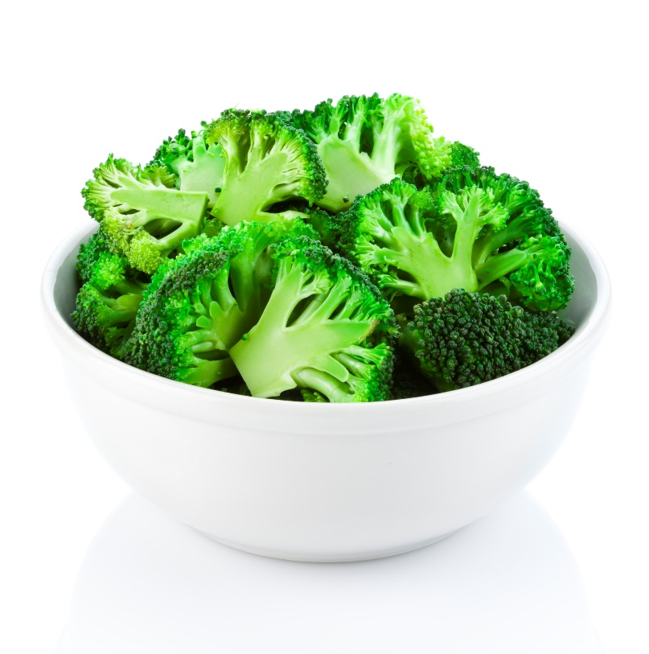
Broccoli!
Click arrow to return to game board!

Slide 11
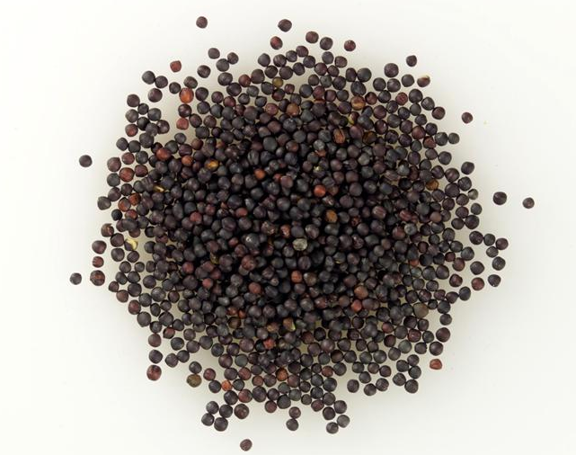
I am canola seed. You don’t normally eat my seed, but I’m found in many products. What do you use me for?

Slide 12
I am crushed for cooking oil and used in sunscreen, cosmetics and plastic wrap. The crushed up seed is also used in pet food, livestock feed and fertilizer.
Click arrow to return to game board!

Slide 13
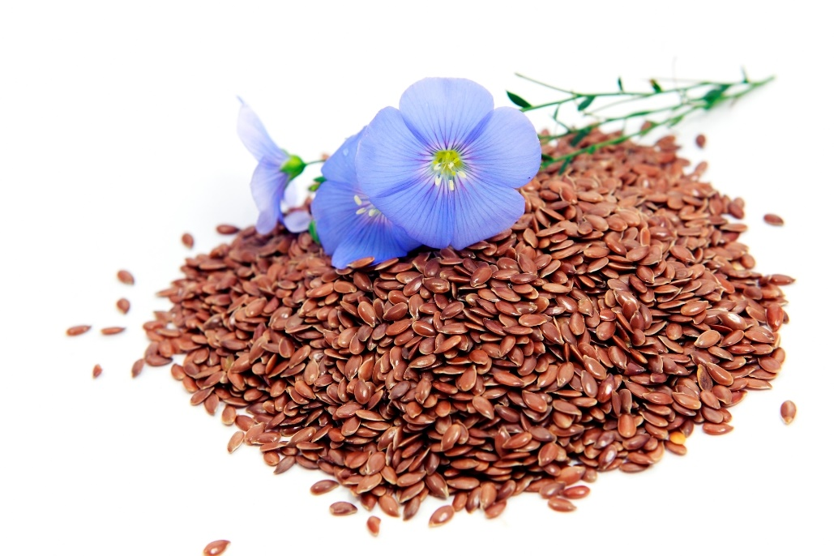
I am flax seed. Sometimes you eat me, but what else am I used for?

Slide 14
My plant stems are used to make linen cloth and paper money. The linseed oil from my seeds can be found in paints, putty and linoleum flooring!
Click arrow to return to game board!

Slide 15
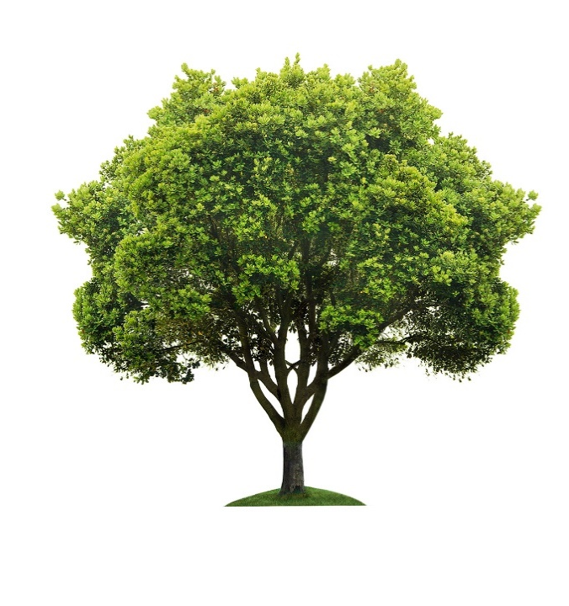
I am a tree. You cannot eat my wood, so what am I used for?

Slide 16
My wood is used for lots of things such as building houses and furniture. Pencils are made out of my wood. I am also turned into pulp and made into paper. I produce oxygen for all living things!
Click arrow to return to game board!

Slide 17
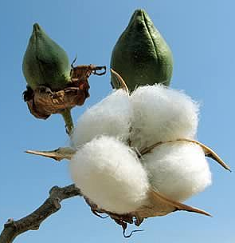
I am a cotton plant.
I kind of look like a marshmallow but you can’t eat me!
What am I used for?

Slide 18
I am used to make lots of clothing, like T-shirts and socks. If you look at the tags on your clothes at home, most of those will have some cotton in them!
Click arrow to return to game board!

Slide 19
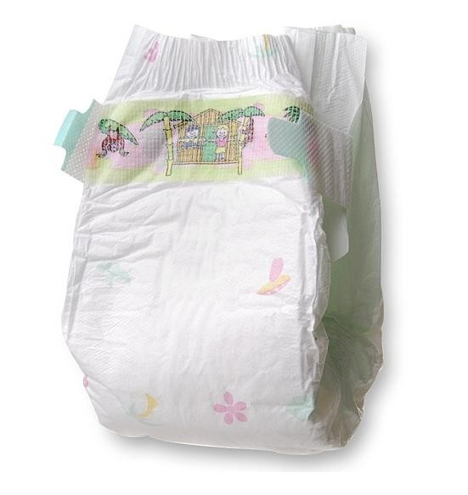
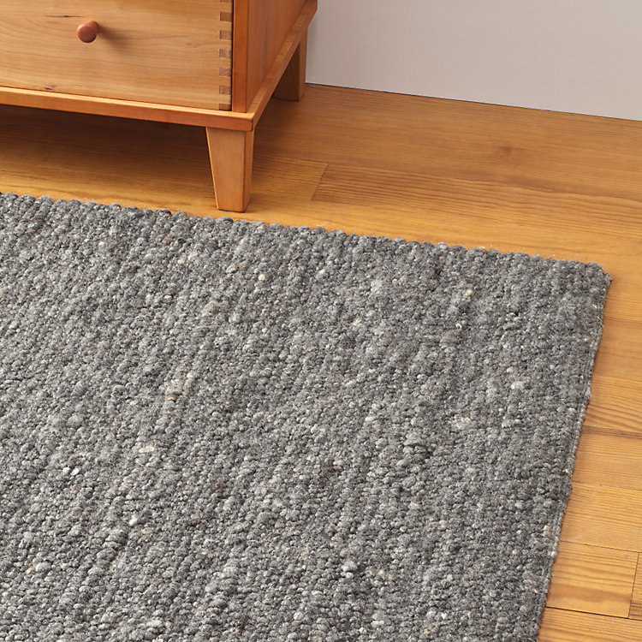
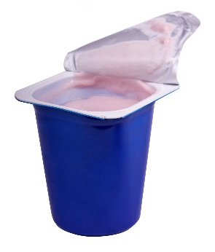
Which crop is used to make baby diapers, carpet and yogurt?
Oats
Corn
Flax

Slide 20
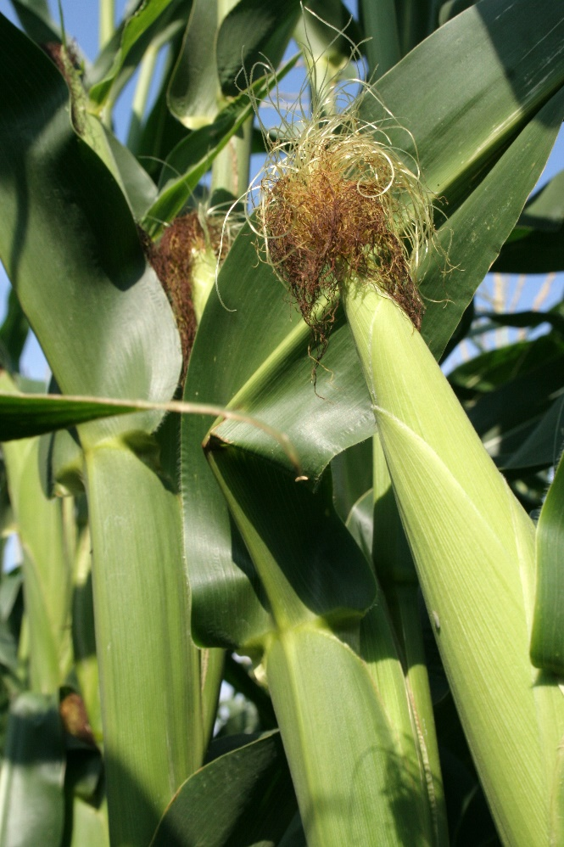
Corn!
Click arrow to return to game board!

Slide 21
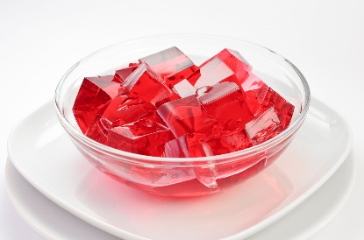
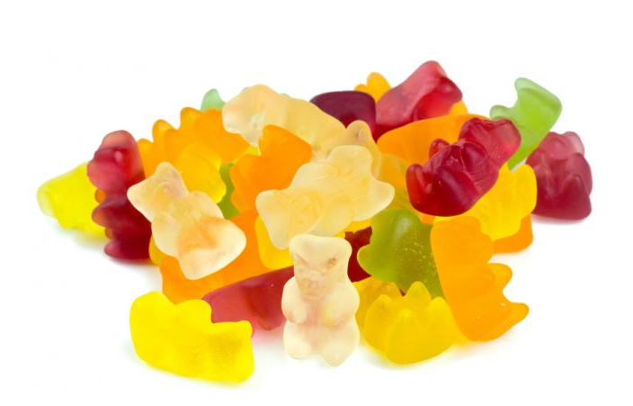
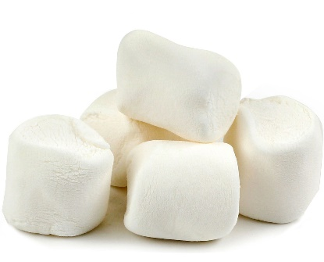
This by-product from which animal is used to make marshmallows, Jello and gummy bears?
a. Chicken b. Pig c. Sheep

Slide 22
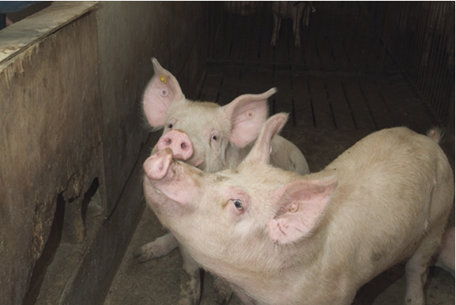
Gelatin from pigs!
Click arrow to return to game board!

Slide 23
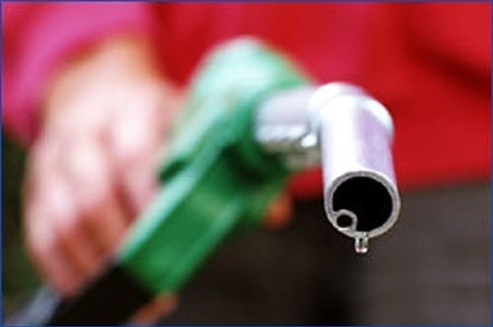
Which grain crop is used to make gasoline?

Slide 24
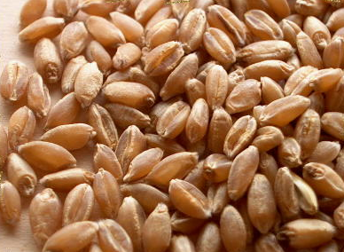
Wheat!
Click arrow to return to game board!

Slide 25
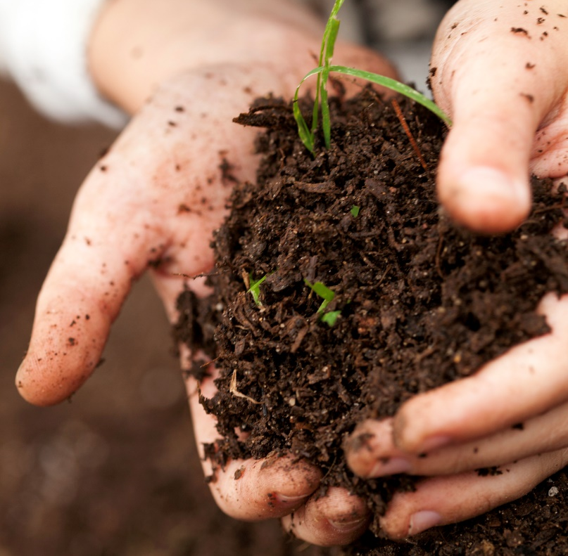
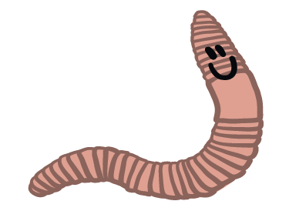
Worms make compost by recycling things from nature. What is compost made out of?

Slide 26
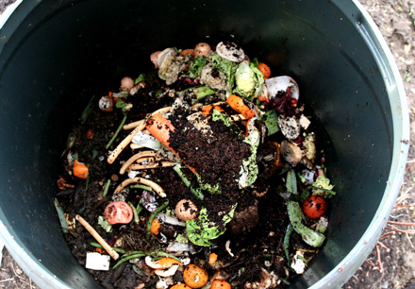
Compost is made from decayed food scraps, leaves and grass !
Click arrow to return to game board!

Slide 27
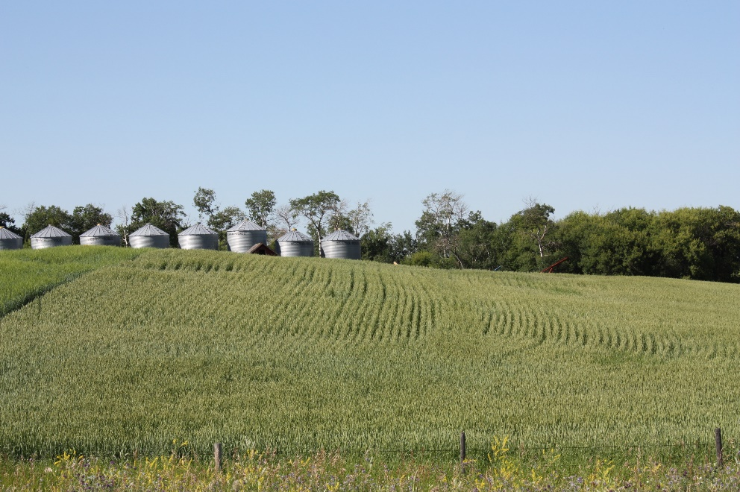
How much of the total land on Earth is used to grow food?
50%
25%
80%
Less than 10%

Slide 28
Less than 10 percent!
Click arrow to return to game board!

Slide 29
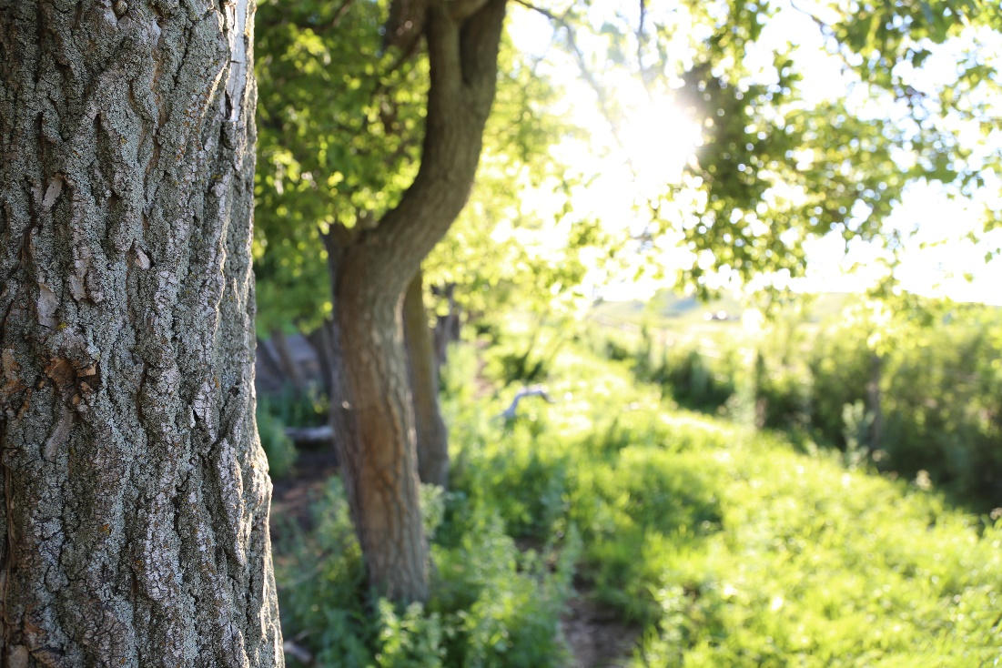
An area where a plant or animal normally lives and grows is called a…?

Slide 30
Habitat!
Click arrow to return to game board!

Slide 31
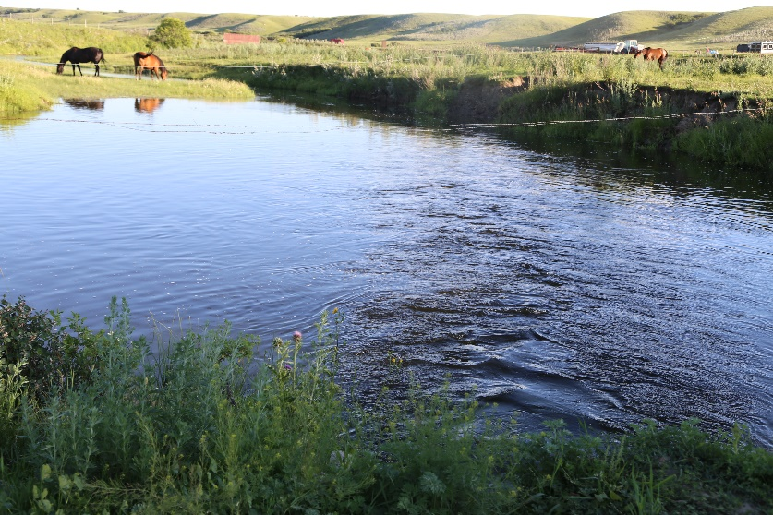
All humans, plants and animals need water. How much of the Earth’s water can be used for drinking?

Slide 32
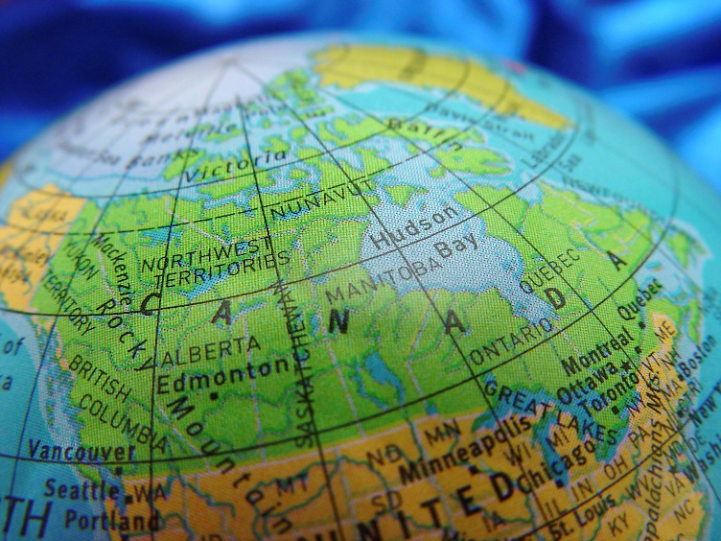
Less than 1% of the Earth’s water can be used by people! 98% is salty or undrinkable and 2% is frozen or stored as ground water!
Click arrow to return to game board!

Slide 33
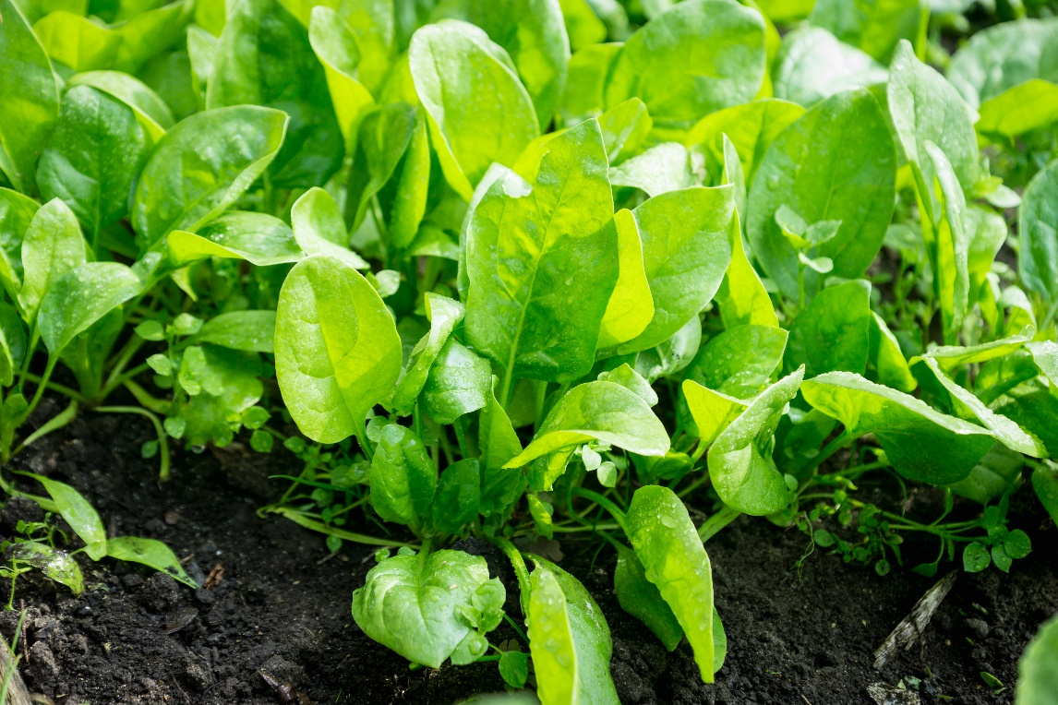
Name 4 basic things that plants need to grow.

Slide 34
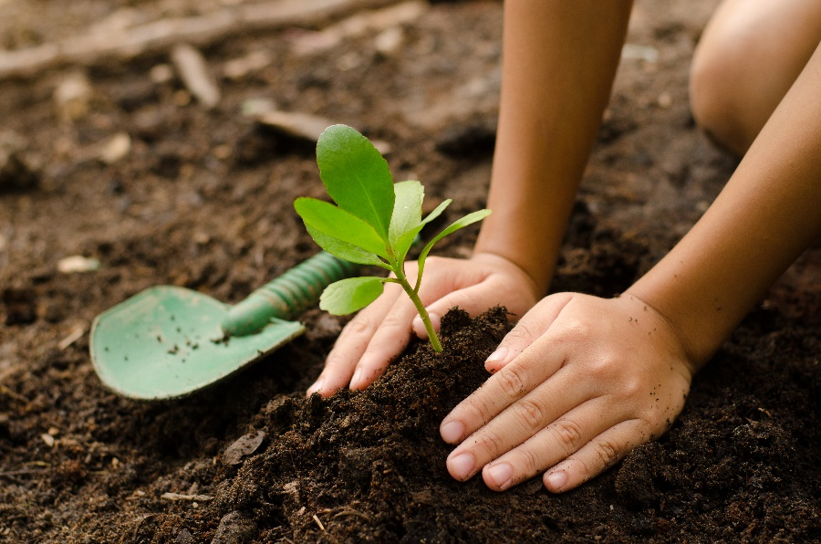
Light
Water
Air
Nutrients (can be from soil )
Click arrow to return to game board!

Slide 35
Thank-You for playing Plant Jeopardy!

